Slide 1
Predicting Property Sale Prices
Letting clients know what their house is worth
…accurately
Data Science @ Regression Realty, Inc
Akram Sadek, James Goudreault, Rishi Goutam, Srikar Pamidi
Internal Briefing, March 10, 2011

Slide 2
Today’s Discussion
Data
Cleaning
Feature Engineering
Notable Findings
Predictive Models
Accuracy Scores
Model Complexity
Statistical Validation
Hyperparameters
Q&A
Predicting House Prices in Ames, IA

Slide 3
Data
Cleaning and Feature Engineering

Slide 4
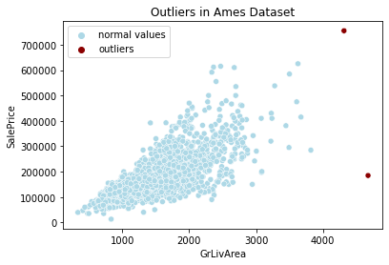
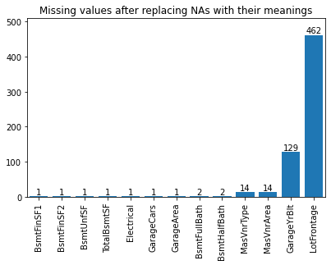
The data - cleaning
Dataset of 2580 properties sold in Ames, Iowa from 2006-2010
80+ features From Ames City Assessor’s Office (not traditional MLS data sources)
Cleaning Dropped 1 duplicate
Removed 2 outliers
Imputed missing values by mean/median/mode of group
or 0 where value might not exist

Slide 5
The data - feature engineering
New features
The school district a property lies in (Edwards, Fellows, Mitchell, Meeker, Sawyer, Unknown)
Interest Rate (TNX index) for the month the property was sold
Derived features
Ordinalize some categorical features
(*Qual/*Cond, Neighborhood, etc)
Combined multiple features into single feature
(StreetAlley, Total Outdoor SF, etc)
Collapse features into smaller set of categories
(MSSubClass, etc)
Others
(number of floors, property age, etc)
Boolean Indicators
Whether a property
is near an arterial road or near a railroad
is in a Planned Unit Development (PUD)
is near a park, green-belt, or other positive amenity
has been renovated or has a pool
others

Slide 6
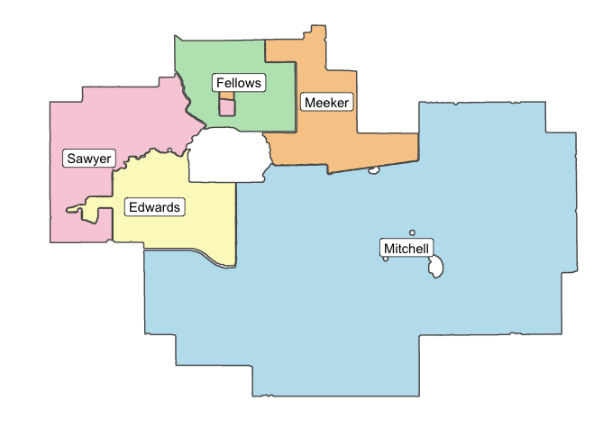
New Feature: School Districts
Ames has 5 public school districts
Determine if a property’s coordinates fall within school district region to get district
We might expect house prices to vary based on the district*
* School districts found to be highly multicolinear with Neighborhood

Slide 7
Notable Findings
Exploratory data analysis informed feature selection and engineering

Slide 8
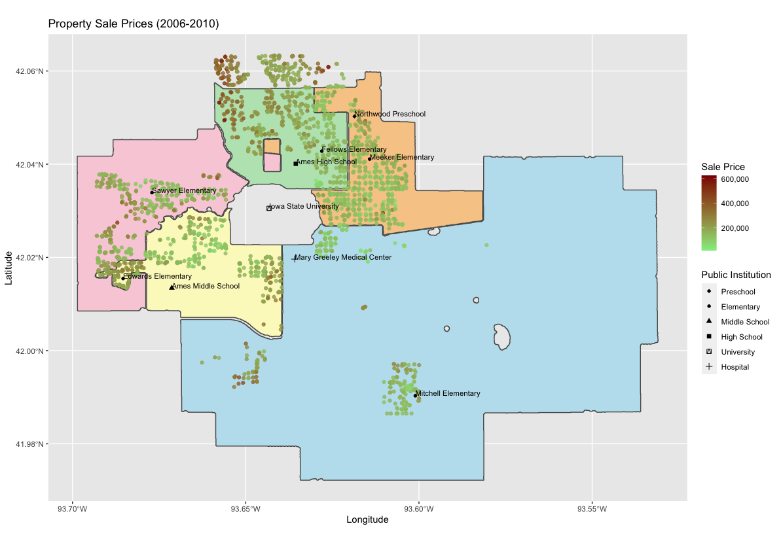
Sale Price
Houses at the outskirts of town cost more than those at the center
Perhaps cheaper housing caters to Iowa State University students?
Or, are there other reasons?

Slide 9
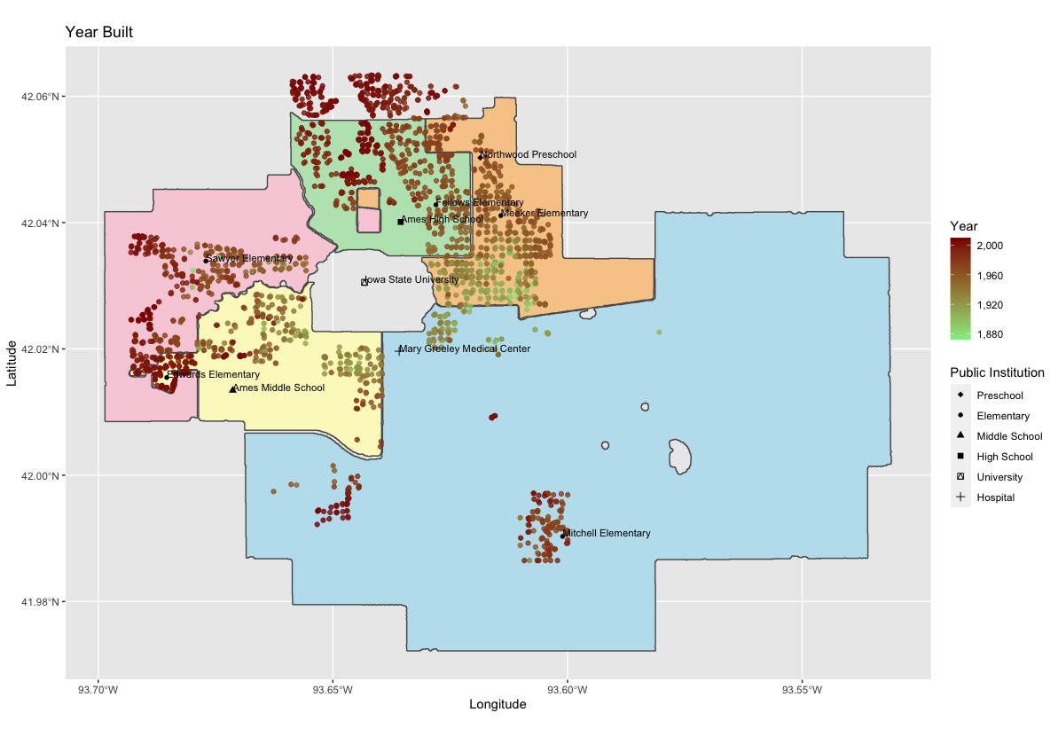
Year Built
Newer houses tend to be more expensive
They are also built on the outskirts, away from the older parts of the city
…and away from the university
…not much market incentive to provide students with new housing near ISU

Slide 10
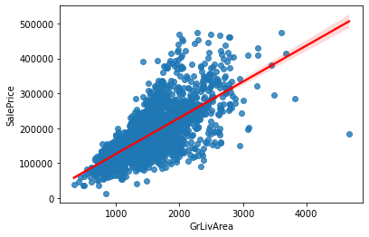
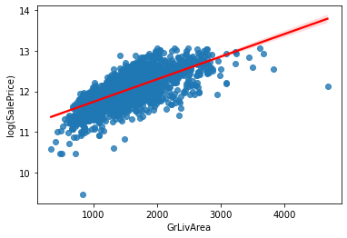
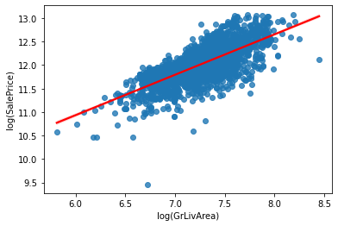
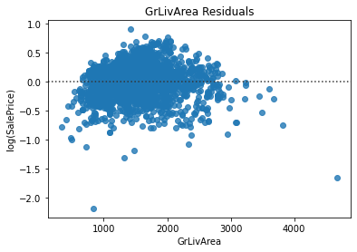
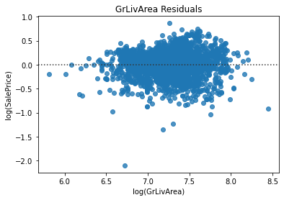
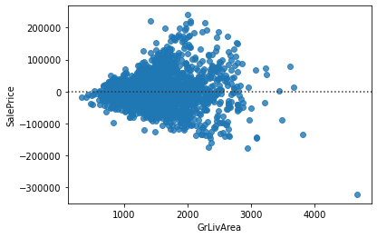
Area features display increasing variance
Linear-Linear
big improvement
Log-Linear
some improvement
Log-Log

Slide 11
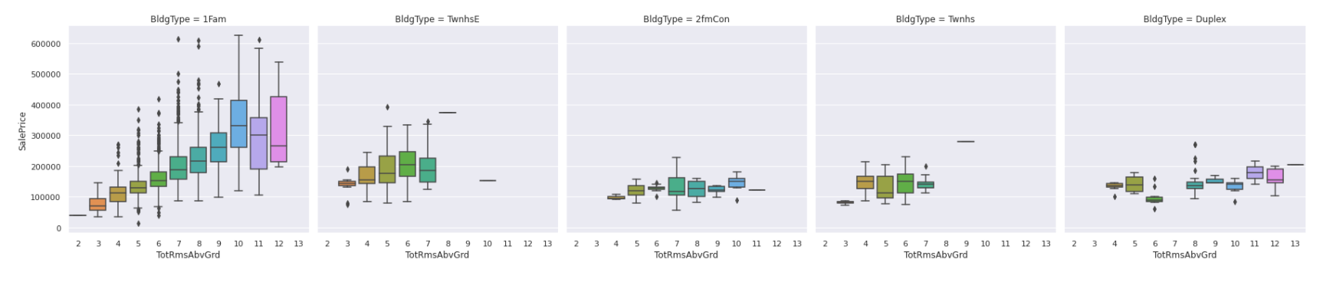
Size matters…in some cases
The price of a single family home is strongly correlated with the number of rooms in the home.
Not so with other home types

Slide 12
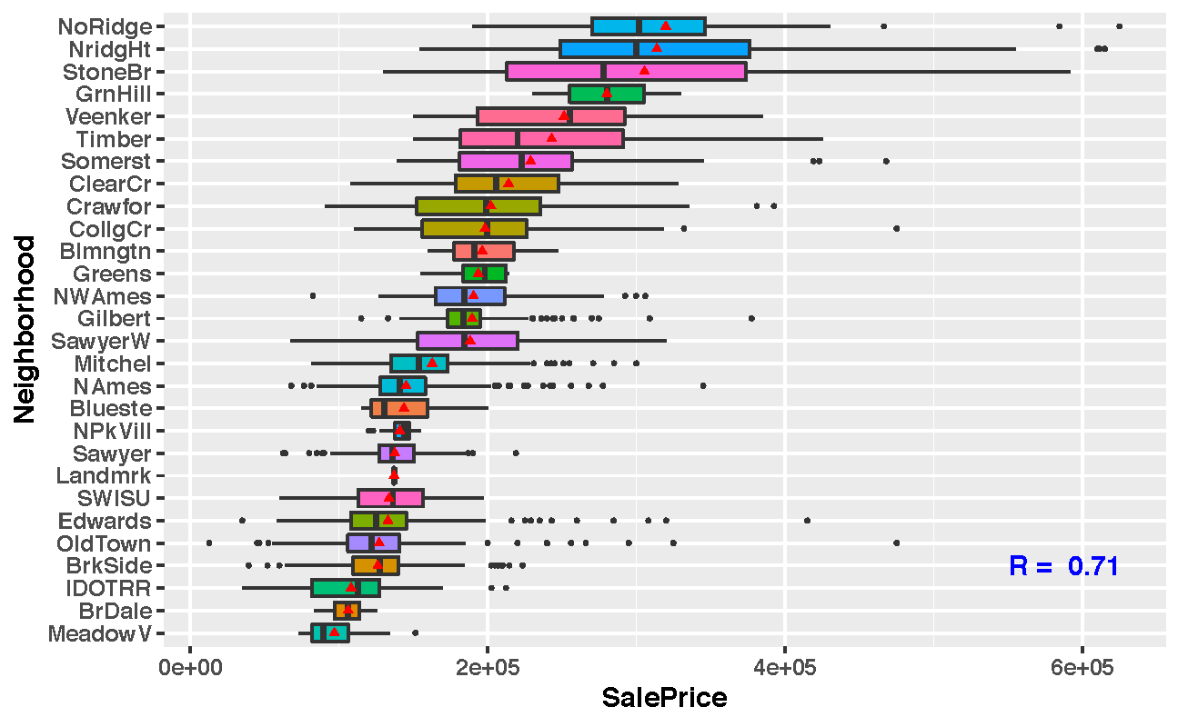
Neighborhood is Strongly Predictive
Neighborhood is highly correlated with home sale price
Neighborhoods were arranged in order of mean sale price to obtain a ranking
Ranking was used to create a new feature to describe each neighborhood as an ordinal integer
(0, 1, 2, … , 26, 27)

Slide 13
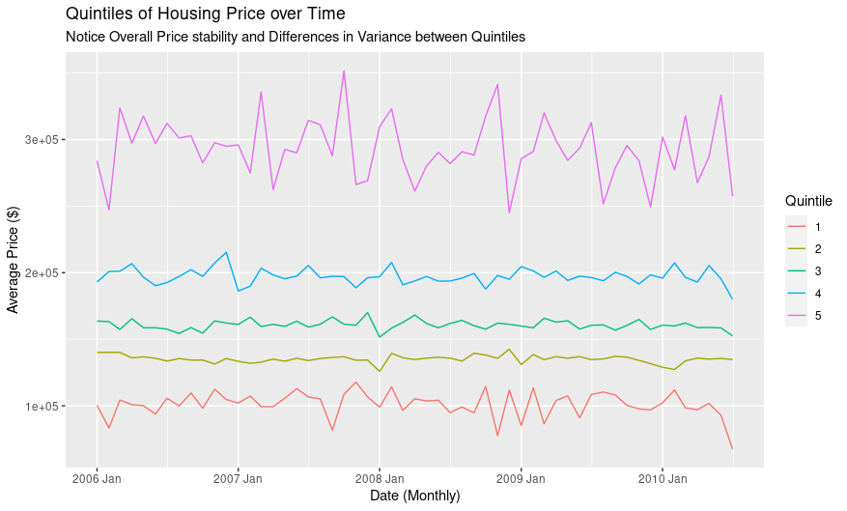
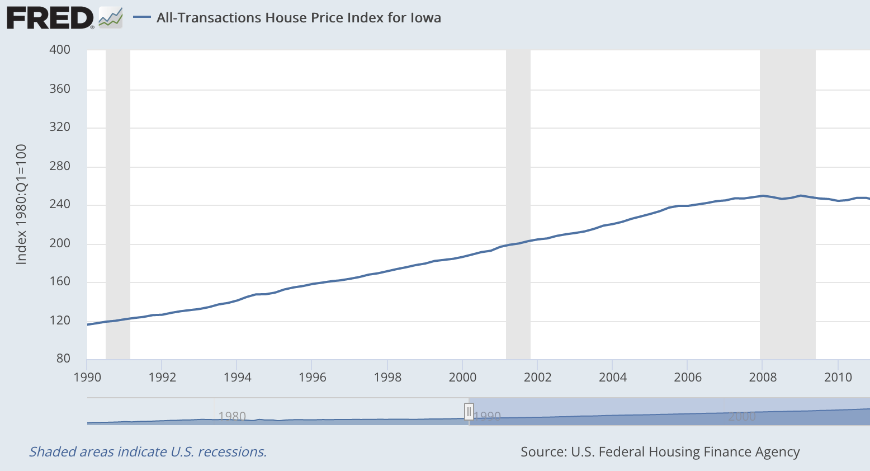
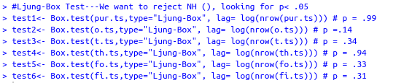
2006-2010: An anomaly?
Ames house prices have been flat in this period…
…instead of showing the steady increase seen across Iowa in the recent past.
This is despite interest rates dropping after 2008
Flat

Slide 14
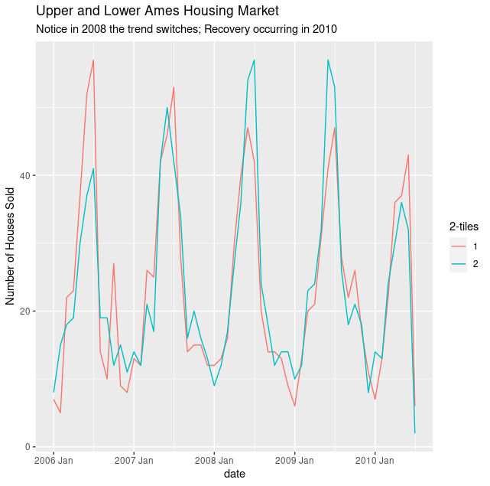
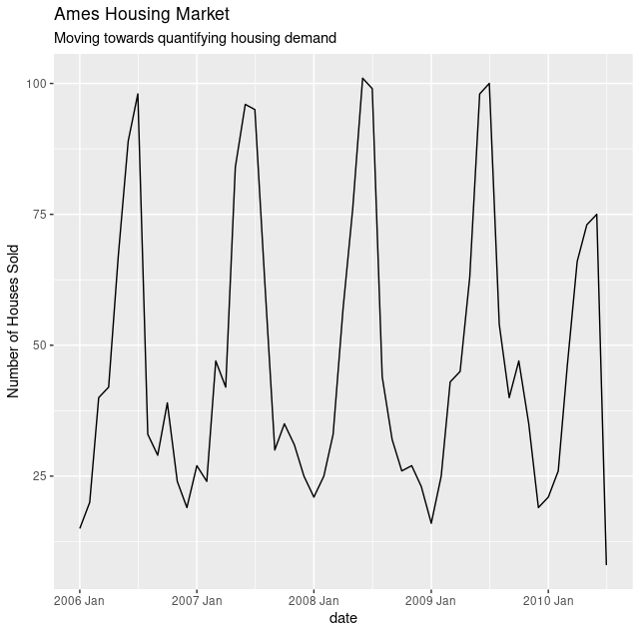
Seasonality and Effect of 2008 Crash
Sales exhibit seasonality…
…with more summer sales than sales in winter
We see a shift towards more sales of cheap houses than expensive houses
Are affluent owners hoping to weather the storm?
}

Slide 15
Predictive Models
Linear Regression & Elastic-Net
Tree Models
SVR
Neural Network
Time Series

Slide 16
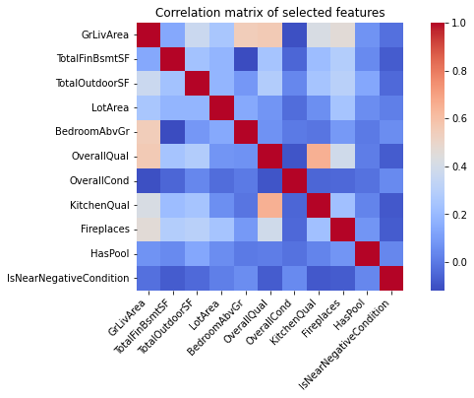
Linear Regression
&
Elastic-Net
 | Basic | Final | Elastic-Net
R² Train | 0.9184 | 0.9378 | 0.9331
R² Test | 0.9020 | 0.9113 | 0.9221
RMSE | 0.1232 | 0.0501 | 0.0462
AIC† | 3489.04 | 3377.0 | 229.4
BIC† | 13017.63 | 12652.6 | 850.7
Model Scores
ρ
(Basic)
Model Scores + Statistical Validation
†Used custom AIC/BIC function to apply same function on Elastic-Net as on Linear Regression

Slide 17
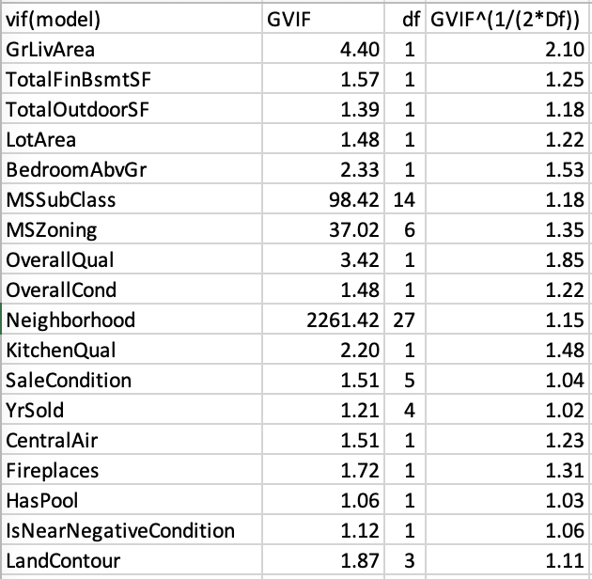
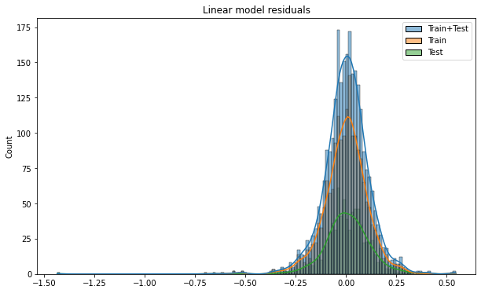
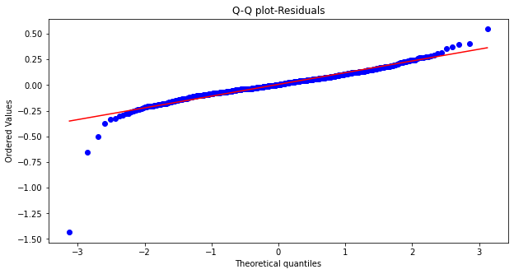
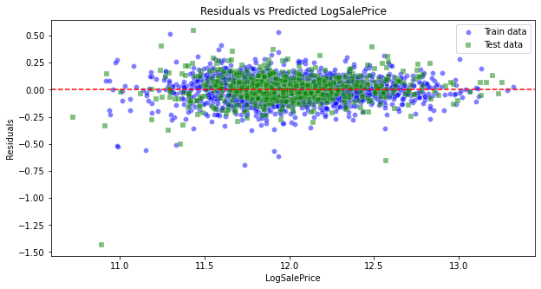
Checking Assumptions
(Basic Model)
Residuals normally
distributed
Low multicolinearity
Residuals are linear
Residuals centered at 0

Slide 18
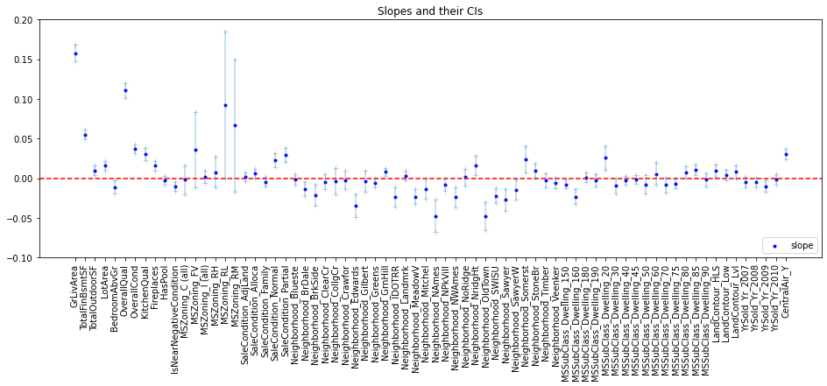
Coefficients
(Basic Model)
HasPool Confidence Interval encompasses 0
(Removed in Final model)

Slide 19
Effect of 1-unit change on mean Sale Price
Linear regression can show the effect of a 1-unit change in a feature, ceteris paribus
Increasing the living area of a home by 1 sq. ft. yields an additional $57.43 to the property’s average sale price
But the same for basement and outdoor areas are just $21.84 and $10.64 respectively
Being near a high-traffic road or rail line decreases value by $7675!
What can an agent recommend?
A fireplace can add $4380 to the sale price
However, might not be cost effective as cost of installation is between 2-5k. Agent to make determination based on fireplace type (gas, electric, etc)
Adding a central air unit increases price by $23599
Given that cost of installation is between 3-15k, an agent can recommend installation

Slide 20
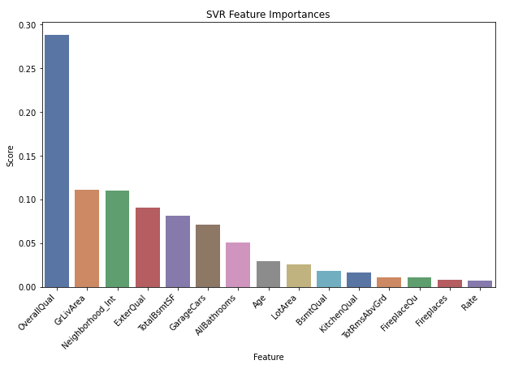
Support Vector Regression
?

Slide 21

Support Vector Regression
 | Before Standardizing |  | After Standardizing
 | Default SalePrice | Default LogSalePrice | Default logSalePrice | Tuned logSalePrice
R² Train | -0.063 | 0.687 | 0.951 | 0.928
R² Test | -0.063 | 0.676 | 0.852 | 0.922
RMSE | x | x | 0.385 | 0.279
Model Scores
Hyper-parameters⁑
* Reported models using logSalePrice for consistency. Models using SalePrice showed marginal improvement (~10-15% in R²), but were more overfit
⁑ Attempted gridsearch to explore other parameters such as kernel=linear/poly but lacked time (>5 hours to run)

Slide 22
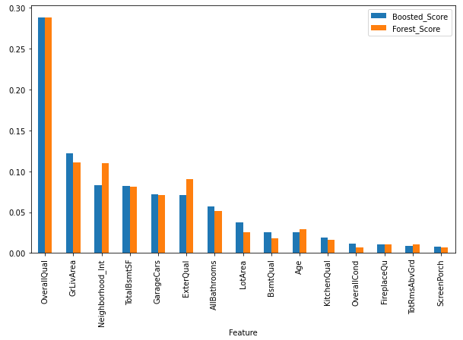
Tree Models
Random Forest
&
Gradient Boosting

Slide 23
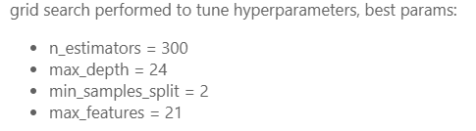
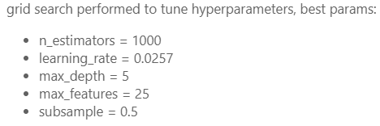
Tree Models - Random Forest & Gradient Boosting
Model Scores
Hyper-
parameters
*reported models using logSalePrice for consistency, models using SalePrice were marginally better (~10-15% improvement in R²)
*attempted gridsearch to explore other parameters such as loss=huber but lacked time (>2hrs to run)
 | Random Forest |  | Boosted
 | Default | Tuned | Default | Tuned
R² Train | 0.987 | 0.986 | 0.985 | 0.994
R² Test | 0.909 | 0.915 | 0.920 | 0.927
RMSE | 0.050 | 0.047 | 0.045 | 0.043

Slide 24
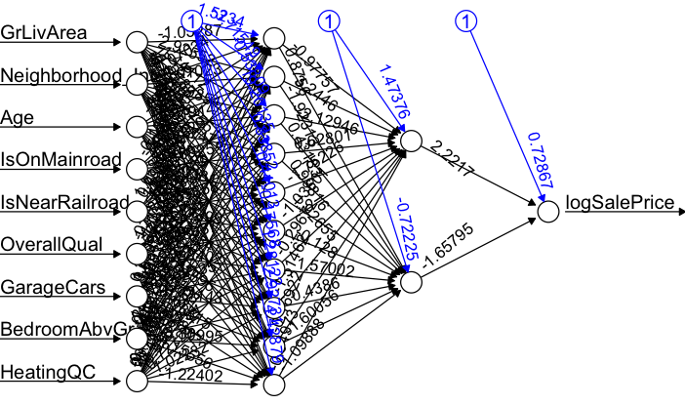
Neural Network
Sub-network of Complete Neural Net
Backpropagation

Slide 25
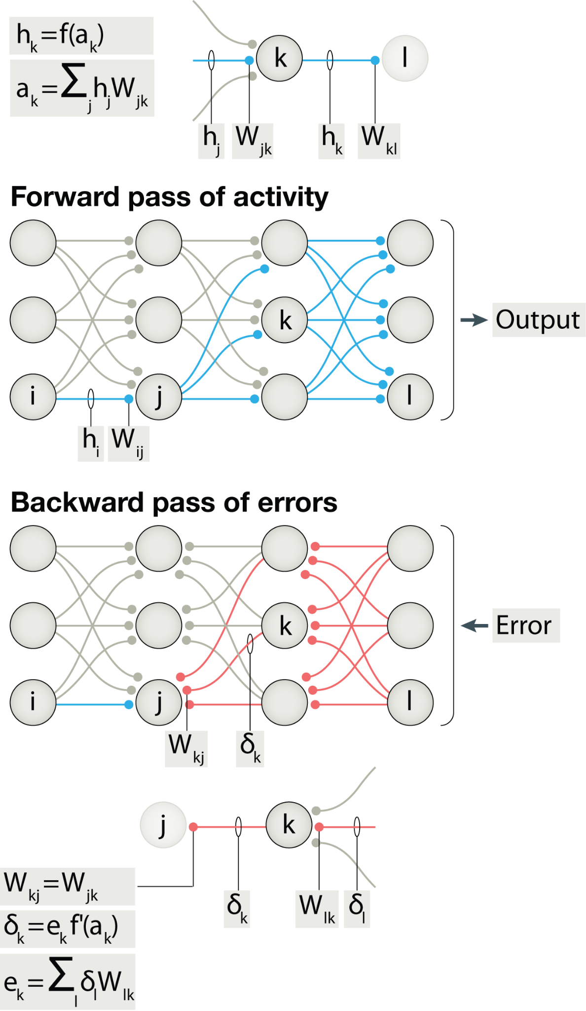

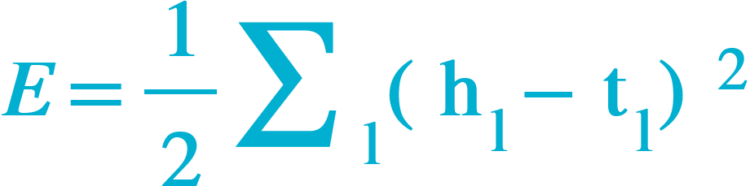
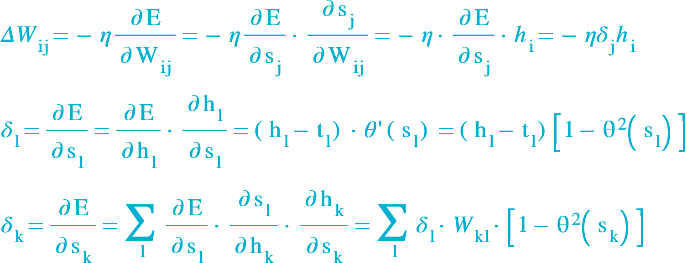
Backpropagation Model
Perceptron - artificial ‘neuron’ that performs weighted sum on synaptic inputs. Output function dependant on weighted sum - could be ‘analog’ or ‘digital’ (fire to 1 if threshold exceeded)
Backpropagation - a forward propagating neural network where backward propagating synapses have been added to the neurons to adjust the synaptic weights based on the final output error
Backprop method - compute for every synaptic weight the gradient of the error ∂E/∂W with respect to the current weight. Use gradient to adjust weight proportionally. Key insight is error can be computed recursively via the chain rule

Slide 26
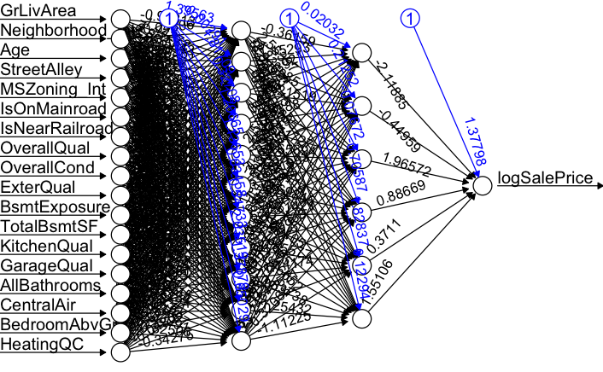
Backpropagation Results
Backpropagation is accurate with far fewer features, making it ideal for our agents, who would need to enter less information for a good sale price estimate
18 inputs
(c.f. with 47 inputs using Elastic-Net)
Two hidden layers (11, 6)
Substantive improvement in model accuracy will become possible with further work.
 | Backprop
R² Train | 0.9366
R² Test | 0.8950
RMSE | 0.0320
AIC | 577.1
BIC | 2160.3

Slide 27
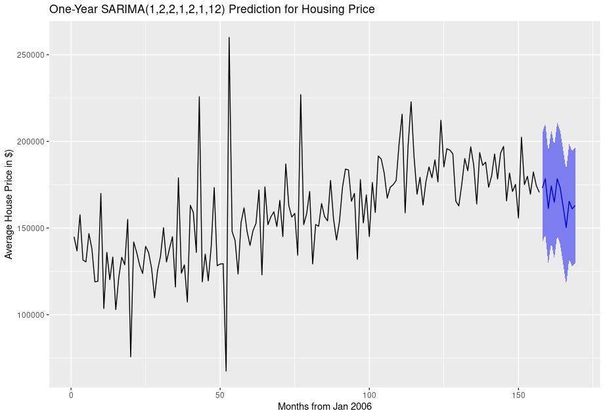
Time Series
Prediction - All House Types
SARIMA

Slide 28
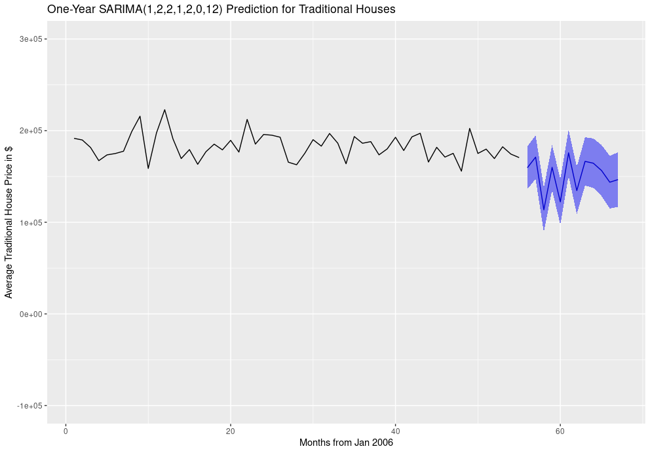
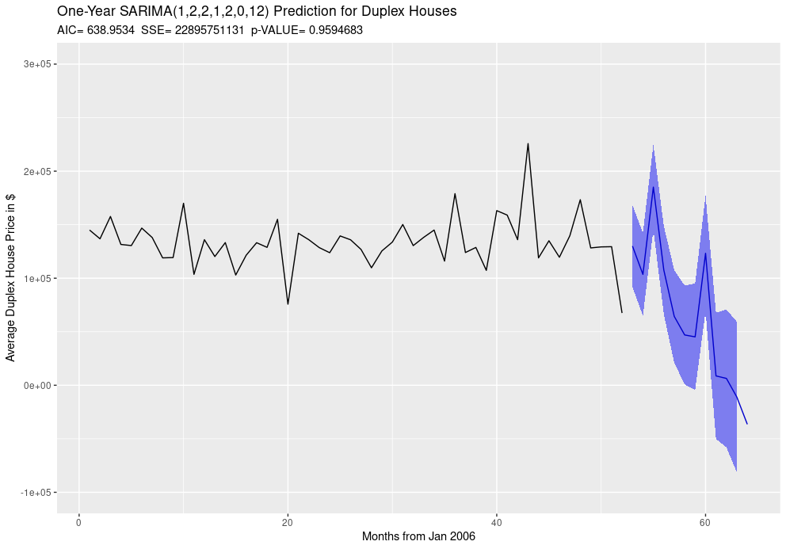
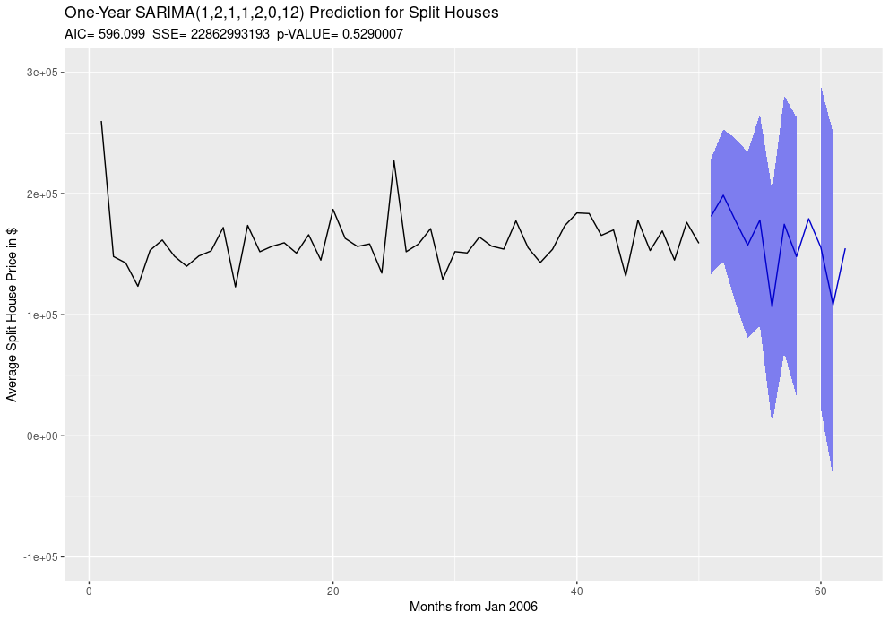
Price Time Series– House Type (Collapse_MSSubClass)
Traditional
Duplex
Split

Slide 29
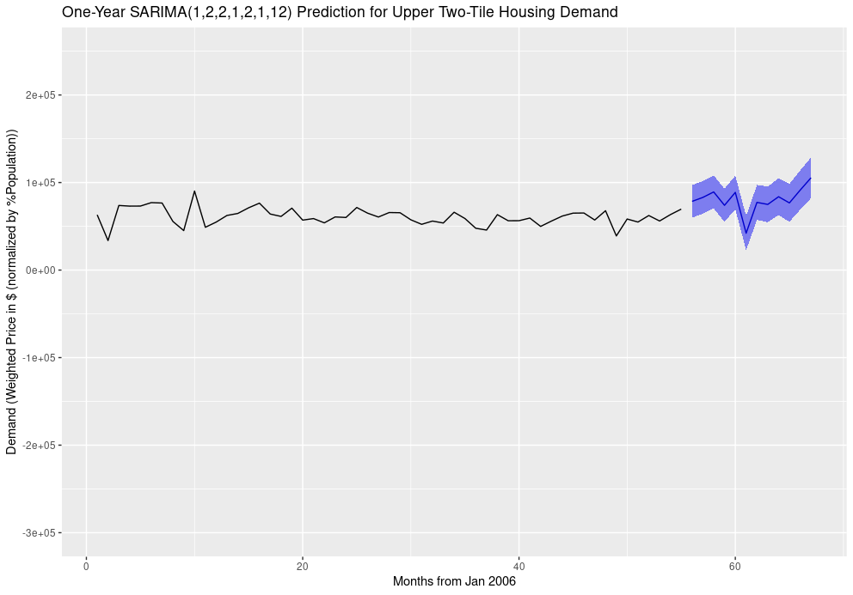
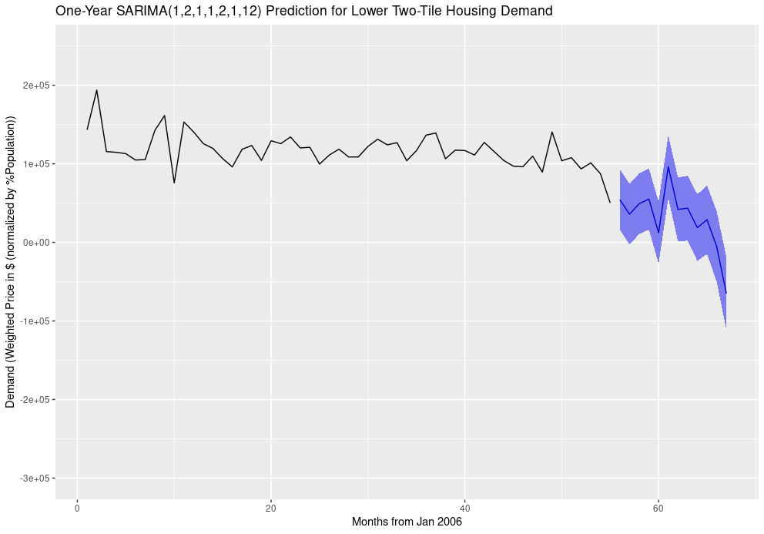
“Demand” Time Series– Upper and Lower 2-Tile
Reveals that “demand” of upper two-tile homes will recover in the next two years*
Cheap
*Assuming our dataset contains all houses on Ames market at that month

Slide 30
Time Series - Average Price
Model Scores
As SARIMA predictions are not based on linear Correlation,
there will not be strong Coeff. Of Determination,
nor will it have much significance.
We checked improvement of our model, if the RMSE decreased
between train and test.
Model Parameters and Coefficients
SARIMA(1,2,2,1,2,1,12)
This is an AR(1)+MA(2), twice-differenced for Weak Stationarity, with seasonal sAR(1)+sMA(1), twice-differenced for Weak Stationarity, over a seasonal period of 12 months.
This means that we have a strong Moving Average component to our model, and it is accounting for many random shocks present in the data. The small number of Auto-regressive components implies there is not as strong a dependence on previous value dictating future value
The Autoregressive components show historical values are accounted for twice: once locally, and once in the seasonal autocorrelation. This explains why our sparse models were not resilient for long prediction timescales.
 | SARIMA
 | Test | Train
R² | 0.077 | 0.528
RMSE | $18,655.99 | $9014.61

Slide 31
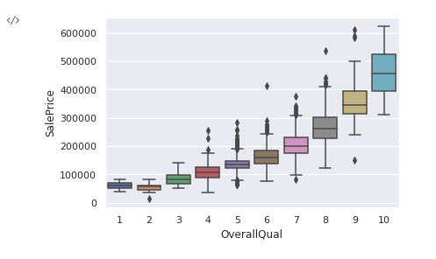
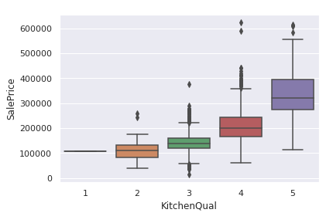
Future Development
Ensemble multiple machine learning models to bring even more accurate predictions
Use log-log for (sale price ~ area features) rather than log-linear
Incorporate MLS data and Household Income data into our model
Investigate impact of distance from Iowa State University
Add interaction and polynomial features
(E.g., some *Qual features appear to be quadratic)

Slide 32
Takeaway
Regression Realty Agents can now Accurately Predict Sale Price!
 | R² Train | R² Test | RMSE
Elastic-Net | 0.933 | 0.922 | 0.046
Random Forest | 0.986 | 0.915 | 0.047
Gradient Boosting | 0.994 | 0.927 | 0.043
SVR | 0.926 | 0.922 | 0.279
Backprop | 0.937 | 0.895 | 0.032
SARIMA† | 0.528 | 0.077 | $14,167.58
Just input the property’s details into our app‡ and get estimated home value
Listing agents
Know the true value of a home instead of guessing. Ensure a home isn’t mispriced, thus on the market for too long or short a time
Selling agents
Know if a home is over- or under-priced and offer bidding advice to your client
‡ Expected by Q3, 2011
† SARIMA used SalePrice (not logSalePrice)
Time series R² cannot be compared to other models as the model is not linear

Slide 33
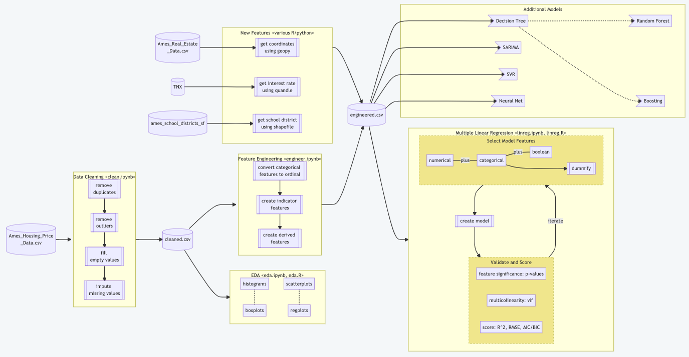

Data Pipeline
//rishigoutam/ames-iowa

Slide 34
References
Ames, Iowa: Alternative to the Boston Housing Data as an End of Semester Regression Project http://jse.amstat.org/v19n3/decock.pdf
Iowa House Prices over Time https://fred.stlouisfed.org/series/IASTHPI
Treasury Yields (TNX)
https://finance.yahoo.com/quote/%5ETNX/
Ames Neighborhoods https://www.cityofames.org/home/showpublisheddocument/1024/637356764775500000
Ames School Districts https://github.com/topepo/AmesHousing/blob/master/data/ames_school_districts_sf.rda
https://www.ames.k12.ia.us/boundaries/
Kaggle Ames Housing Dataset https://www.kaggle.com/c/house-prices-advanced-regression-techniques/data
Fireplace Installation Cost https://homeguide.com/costs/fireplace-installation-cost
Central Air Installation Cost https://www.remodelingcalculator.org/cost-install-central-air/
Backpropagation
Lillicrap, T. P. et. al., “Backpropagation and the brain”. Nat. Rev. Neurosci. 21, 335-346 (2020)

Slide 35
Q&A
Data Science @ Regression Realty, Inc
Akram Sadek, James Goudreault, Rishi Goutam, Srikar Pamidi

